Slide 1
Retail & Food Services Time Series Analysis
Dominick Amalraj, Long Nguyen, Michal Chowaniak

Slide 2
Data Set Description
Dates Back to 1992
Monthly Data (Starting on the first)
December 1, 2018 last data point
Adjusted and Non-Adjusted Sales
Trends and Seasonality of Retail & Food Services Sales
Good data with even time increments

Slide 3
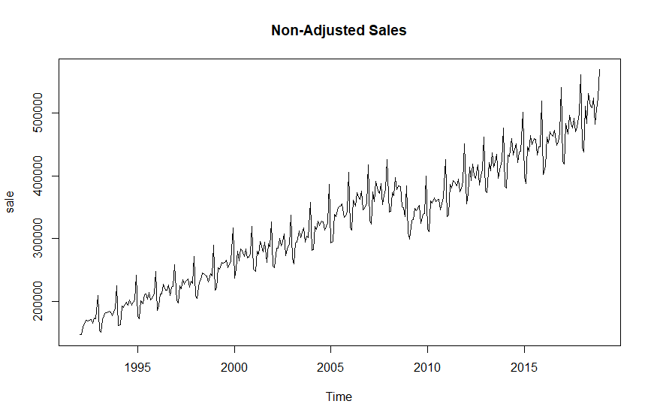
Time Plot of Non-Adjusted Data
Shows a linear increasing trend
Overall goes through similar trends
Seasonality is evident
No Signs of an Autocorrelation time series
Non-Stationary time series
Unusual circumstance & decrease in sales in 2009
Does not follow pattern throughout time series

Slide 4
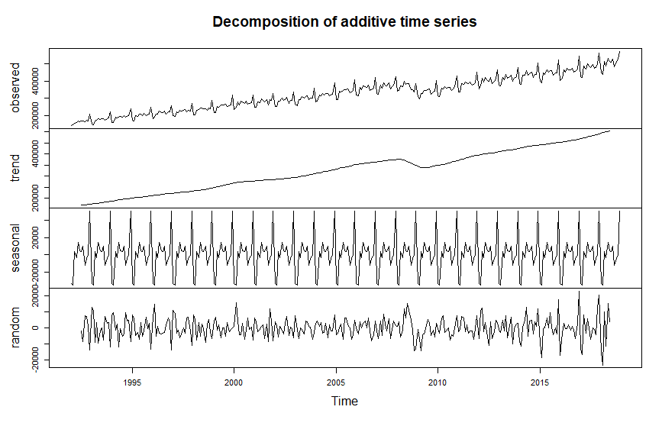
Decomposition Plot
Trend shows the linear increasing path
Decrease in trend plot shows unusual circumstance in time series
Seasonality shows similar patterns of linear trend

Slide 5
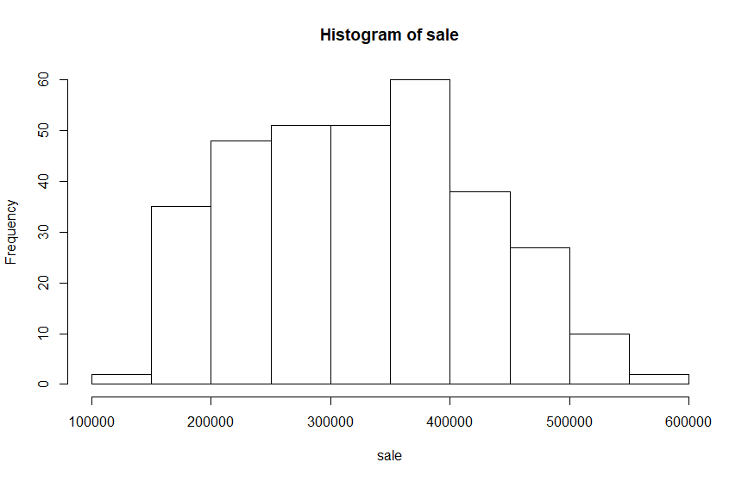
Histogram of Sales
Shows overall normal distribution
Right side of histogram is lower than the distribution on the left
Slightly skewed to the left

Slide 6
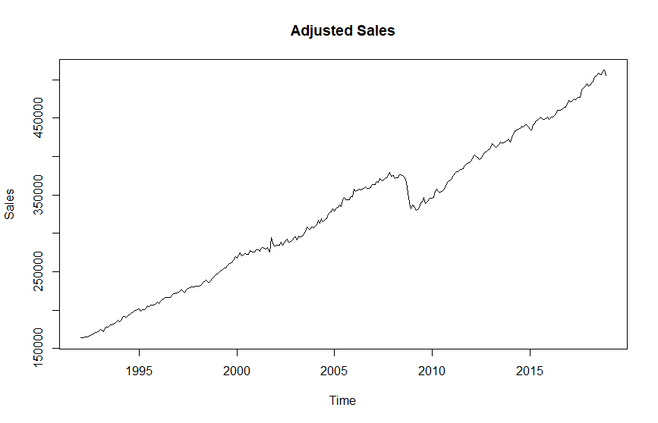
Time Plot of Adjusted Data
Smoother time plot
Less variance and sudden jumps
Still same overall trend
Non-stationary and no sign of an autocorrelation time series
Better to use in forecasting

Slide 7
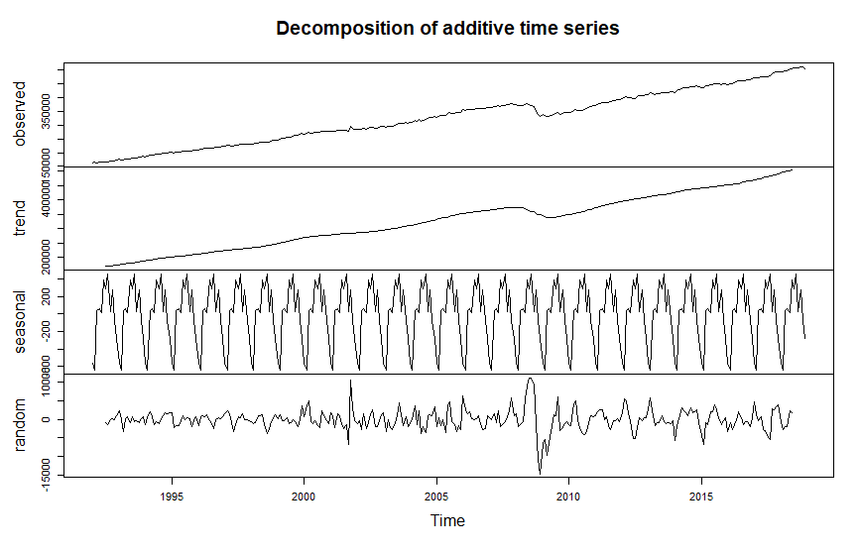
Decomposition Plot
Trend shows linear increasing path
Seasonality little different, yet still high presence
Unusual circumstance still evident in observed and trend plot

Slide 8
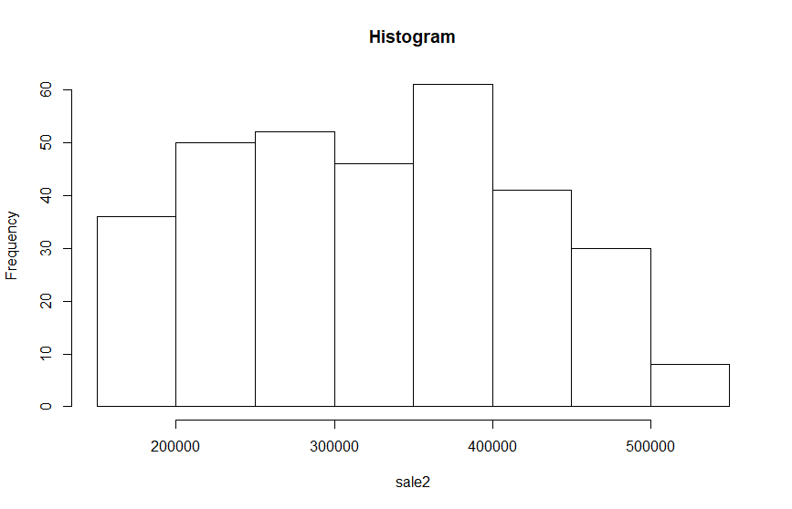
Histogram of Adjusted Sales
Not as normally distributed as non-adjusted data
Less variance so more uniform distribution
Due to less variance, adjusted sales was used for our modeling approaches

Slide 9
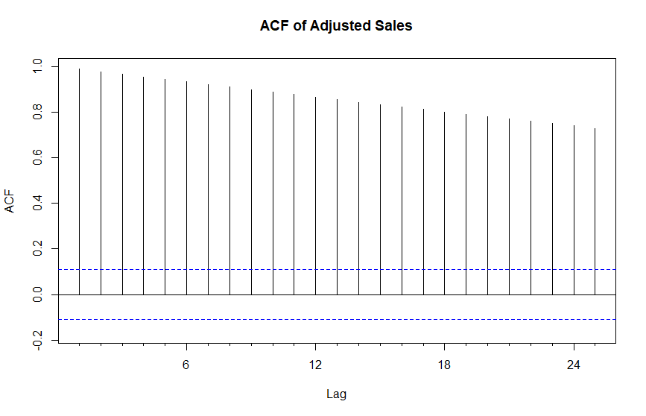
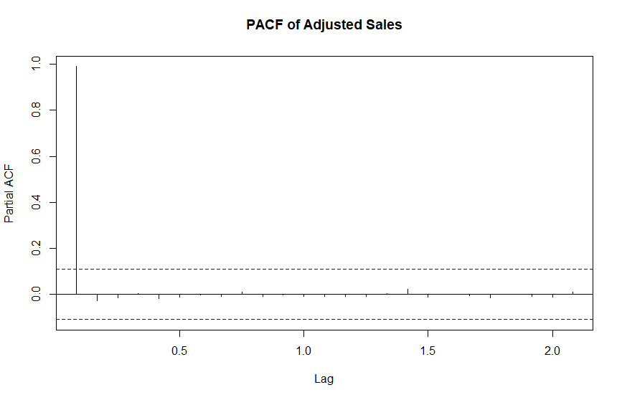
ACF and PACF Plot
ACF decays to zero slowly
Shows it is a non-stationary time series
Not Autoregressive time series
PACF decays to zero quickly
More of a Moving Average Time Series

Slide 10
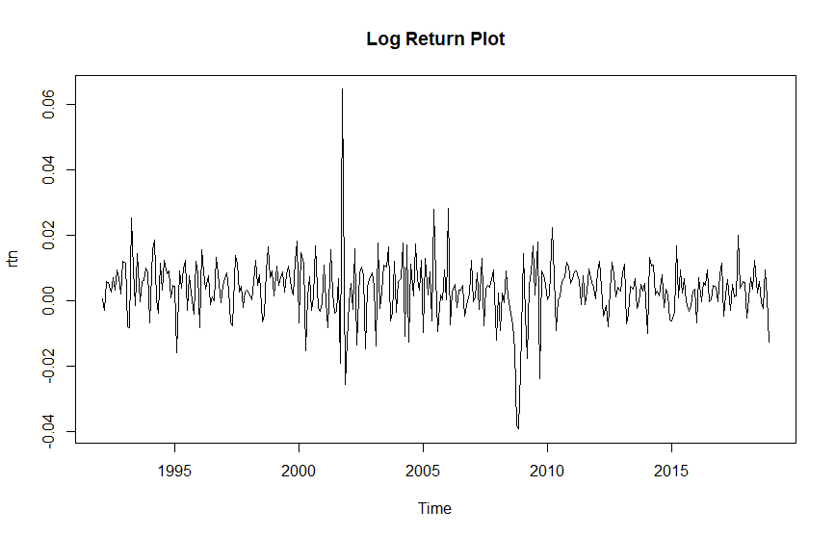
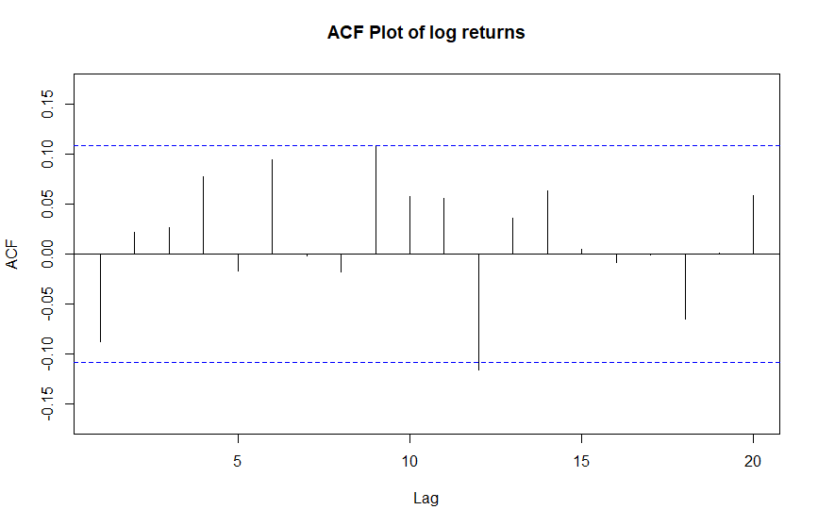
Data Transformations
More stable less variance
ACF plot decays to zero quickly
Time series shows some unusual movements in sales

Slide 11
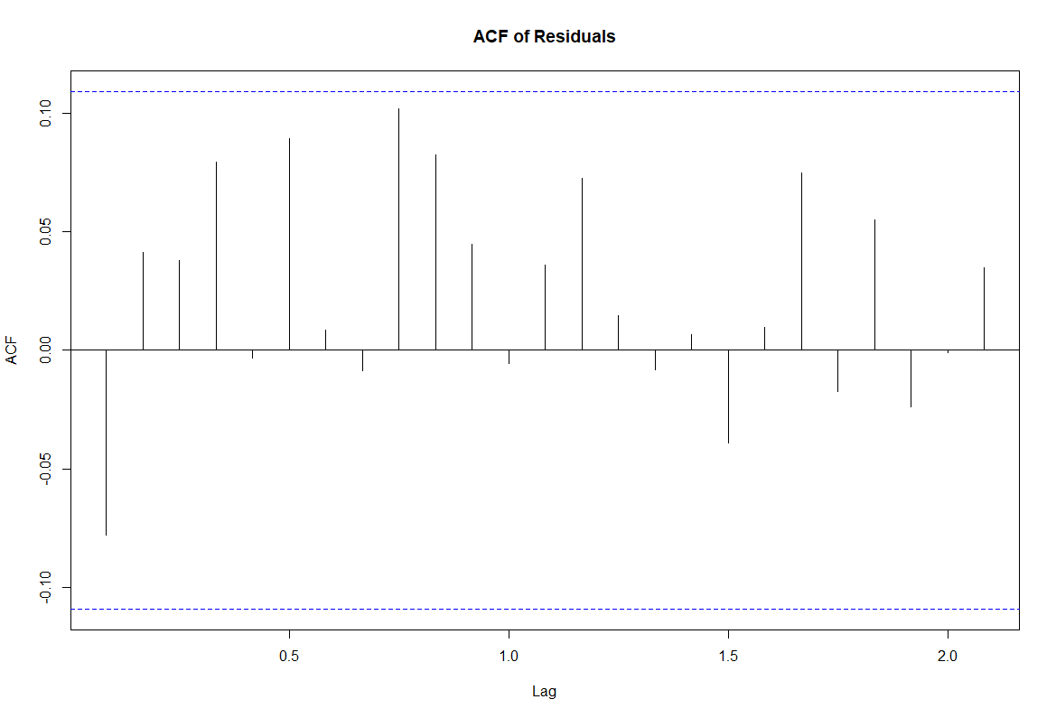
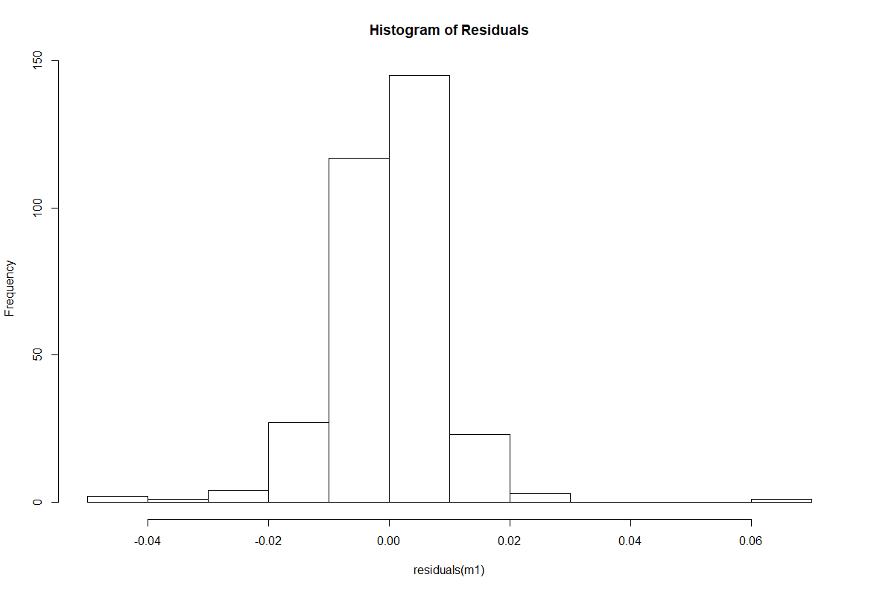
Auto ARIMA
Utilized Auto ARIMA function
BIC Criterion
SARIMA(0,0,0)(0,0,2)
No Autoregressive or Moving Average Components
Seasonality
ACF of Residuals near zero
Normally Distributed
Box Ljung Test accepts hypothesis
Residual Analysis shows an adequate model

Slide 12
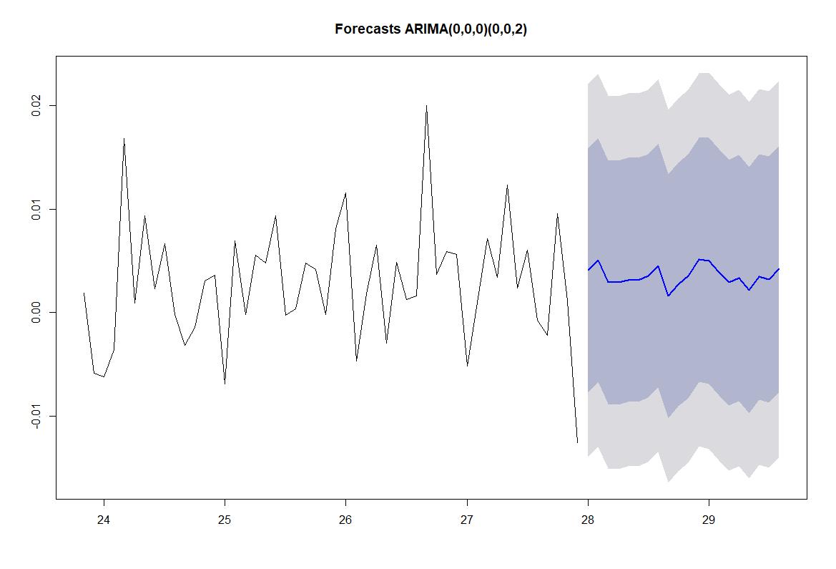
Auto ARIMA Model
BackTesting:
RMSE out of sample Forecasts:
0.01022818
MAE of out of sample Forecasts:
0.007300325
Mean Absolute Percentage Error:
2.190401%

Slide 13
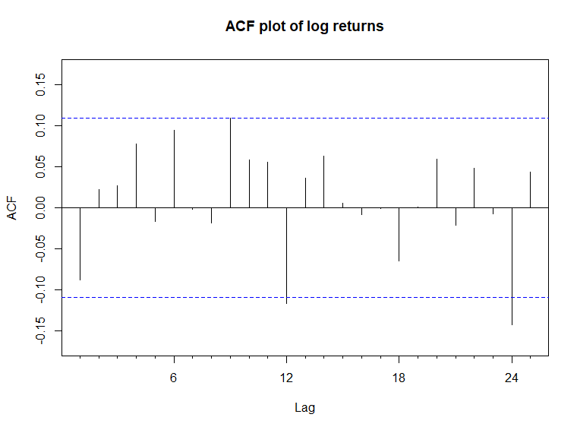
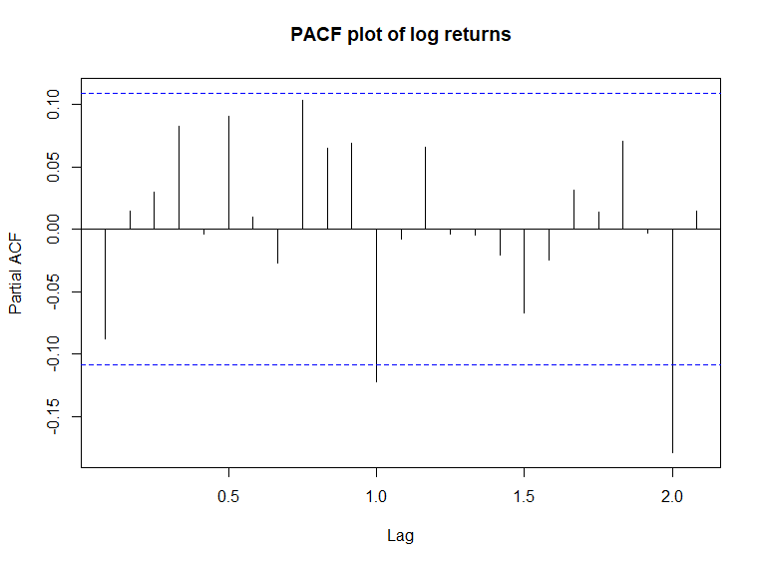
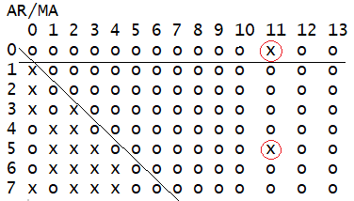
EACF plot
Analysis of log returns series:
ACF and PACF plots show negative correlations at lag 12 and 24 but just around -0.15, hence weak seasonality.
EACF plot also only shows weak seasonality at lag 11.
Dickey-Fuller test rejects the null hypothesis of non-stationary.
Ljung-Box test at lag 6 and 12 cannot reject the null hypothesis of independence.
So, the series is stationary and an SARIMA(0,0,0)(1,0,1)[12] model appears to be a good fit by EACF plot with triangle from (1,1).
Notes:
ACF and PACF plots are of log returns, i use them to show the significant negative correlations at lag 12 and 24, they indicate annual seasonality but very weak as they are just around -0.1 ~ -0.15.
The 2 x in EACF plots that i circled red also shows some weak seasonality at lag 11 (like the column of x if there is strong seasonality).
I also ran DF test and Ljung box tests to show the series is already stationary, therefore an ARIMA(p,1,q) cannot be fitted.
So according to the EACF triangle, i still keep the AR,MA parts to be (0,0,0) but in order to account for the seasonality, i opt for some seasonal components in the model, hence the seasonal part is (1,0,1) with period = 12 (annual seasonality).

Slide 14
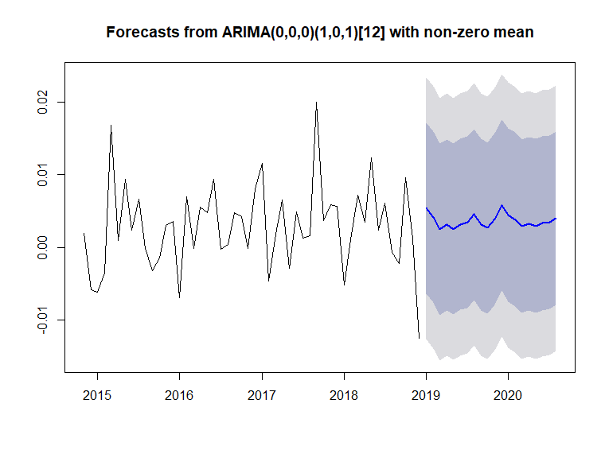
EACF - SARIMA(0,0,0)(1,0,1)[12] model
Backtesting results:
RMSE of out-of-sample forecasts 0.005461 Mean absolute error of out-of-sample forecasts 0.004000 Mean Absolute Percentage error 0.319433% Symmetric Mean Absolute Percentage error 0.947480%
Residuals analysis:
ACF plot shows insignificant correlations.
Ljung-Box test at lag 6 and 12 cannot reject the null hypothesis of independence.
So the residuals are white noise.
Notes:
The forecast went down deeper at first but after that goes same trend as Auto arima model, but with smoother movements.
RMSE is around 0.5%, not very small, considering the standard deviation of log returns is 0.9% and the data moves in range from -3.9% to +6.5% (min to max log returns).
Mean absolute percentage error is good as it is only 0.3%.
I test the residuals by ACF plot and Ljung box test to make sure they have no intercorrelations, are white noise series, indicating a well fit model.

Slide 15
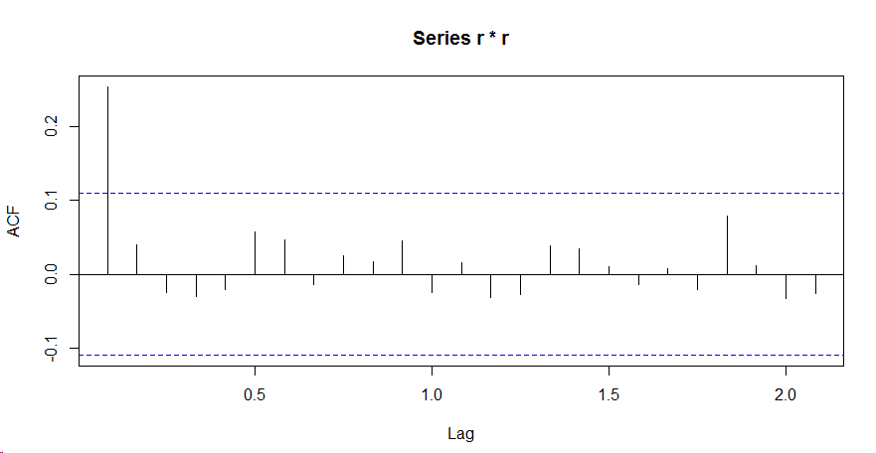
GARCH Model
ACF on log returns - no correlation
ACF on absolute log returns - correlation at lag 1 and minor correlation at lag 22
ACF on squared log returns - correlation at lag 1 (show on the left)
Indicates Garch Model 1 would be best
Based on fGARCH function found combing ARMA(1,1)GARCH(1,1) was best
Notes:
GARCH model residuals main points:
ACF on log returns - no correlation
ACF on absolute log returns - correlation at lag 1 and minor correlation at lat 22
ACF on squared log returns - correlation at lag 1 (show on the left)

Slide 16
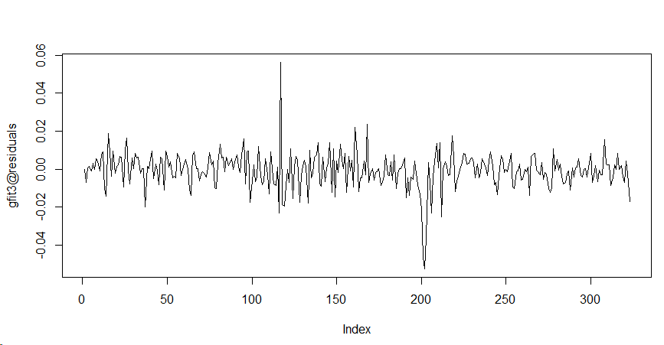
GARCH Model - Residuals
Residuals are uniform except 2 peaks
First peak is around year 2001
Second peak is around year 2008
Notes:
GARCH Model residuals main points:
GARCH Residuals are more uniform except 2 spikes
First peak is around year 2001
Second peak is around year 2008

Slide 17
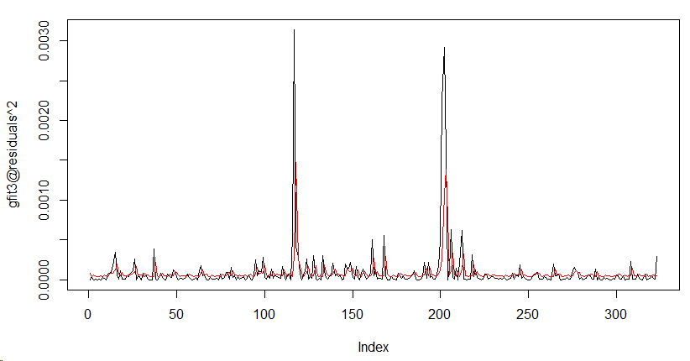
GARCH Model - Scaled Residuals
ACF of squared residuals, one significant lag
Box test - cannot reject white noise
Squared residuals look more uniform. Red line of estimated volatility shows 2 peaks at year 2001 and 2008
Notes:
GARCH model scaled residuals:
ACACF of squared residuals had one significant lag
Box test showed that we cannot reject white noise
Squared residuals look more uniform. Red line of estimated volatility shows 2 peaks at year 2001 and 2008

Slide 18
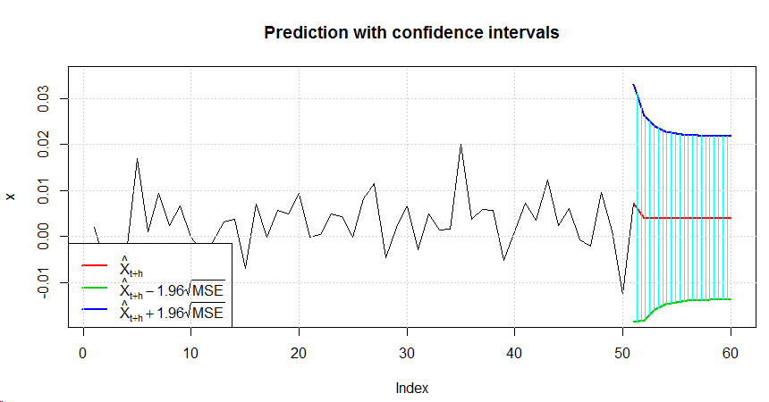
ARMA(1,1)Garch(1,1) - Backtest and Evaluation
BackTesting:
RMSE out of sample Forecasts:
0.007394
MAE of out of sample Forecasts:
0.005234
Mean Absolute Percentage Error:
1.9097%
Notes:
BackTesting on GARCH model provided following results, which were later on compared to other modes
RMSE out of sample Forecasts:0.007394
MAE of out of sample Forecasts:0.005234
Mean Absolute Percentage Error:1.9097%

Slide 19
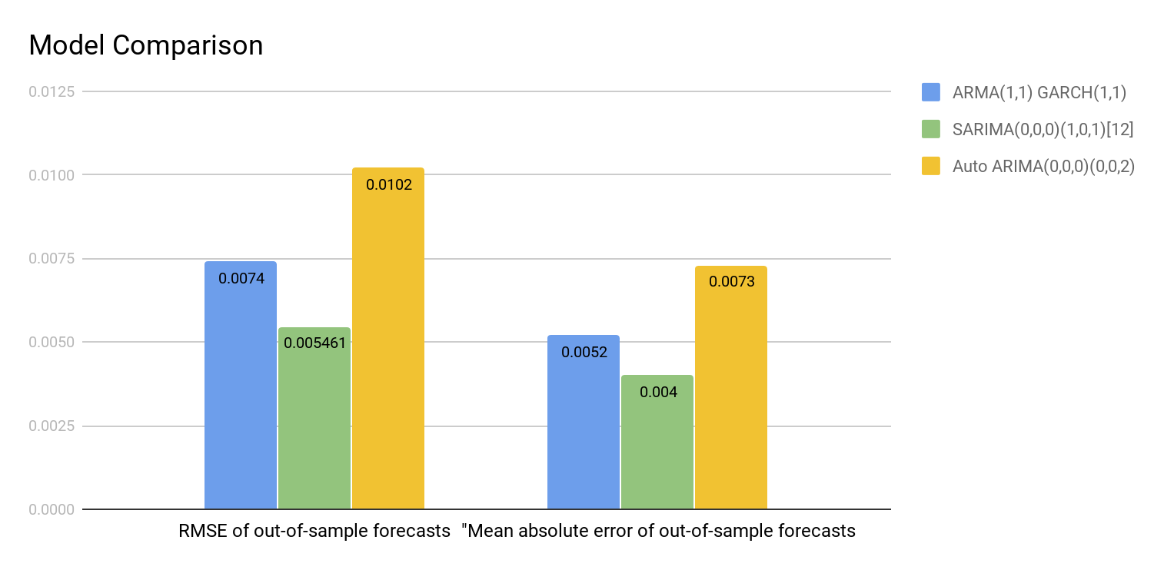
Model Comparison
Notes:
We used backtest function to compare all 3 models.
The lowest and the best value for RMSE and Mean Absolute Error was achieved by SARIMA(0,0,0)(1,0,1)[12]

Slide 20
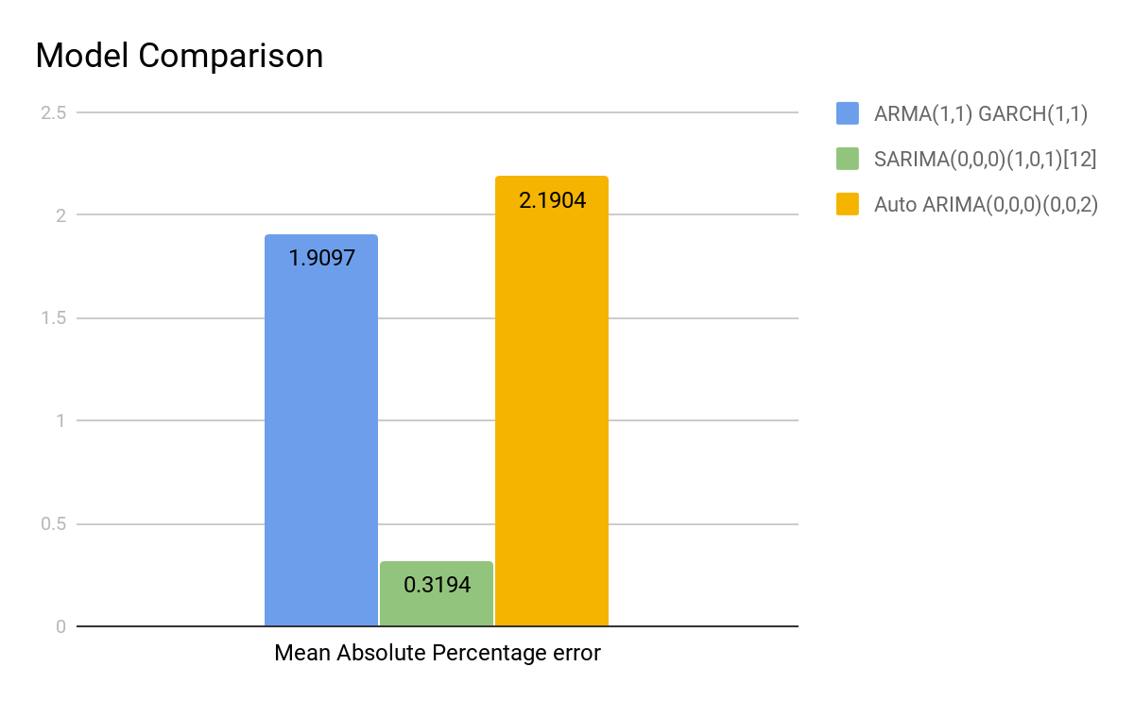
Model Comparison
Notes:
The lowest and the best value for Mean Absolute Percentage Error was also achieved SARIMA(0,0,0)(1,0,1)[12]
The best overall model for Monthly Sales for Retail and Food Services was awarded to SARIMA(0,0,0)(1,0,1)[12]

Slide 21
Limitations
Time plot shows a linear growth
No Autoregressive or moving average exhibited in time series
Were not able to identify a model that involves the sudden and random drop in retail sales
Intervention Model

Slide 22
Conclusion
The best overall model for Monthly Sales for Retail and Food Services index was SARIMA(0,0,0)(1,0,1)
ARMA(1,1)Garch(1,1) performed next best
All models did an adequate job based on the backtesting
Data was difficult based on no exhibits of an autocorrelated or moving average series
Intervention model would be good to test

